Slide 1
Capstone Build
Sports Fantasy Application using Machine Learning
Submitted by,
Goutham Ganesh Shanbhag
Joginder Prathap Singh N
Jomi Thomas
K Harsh Mohan

Slide 2
Problem Statement
Creating Recommendation model for fantasy application

Slide 3
Abstract
Sports fantasy websites have become increasingly popular in recent years, with millions of users participating in fantasy leagues and competitions.
These websites allow users to create their own teams and compete against others based on the real-life performance of professional athletes.
It can also be used to predict the winner or winning team in the real sports tournaments with prize points by which sports goodies can be bought by the winner with significant points.
This website focuses on fantasy games based only on cricket.

Slide 4
Methodology
Users start by registering on the platform. After registration, users need to select the current playing 11 from each of the teams.
Once the selection is completed user need to submit the playing 11 from both the team.
The machine works on the scores, past records, pitch condition, and other parameters and selects the best performing players among the 22 players.
And the result is printed.

Slide 5
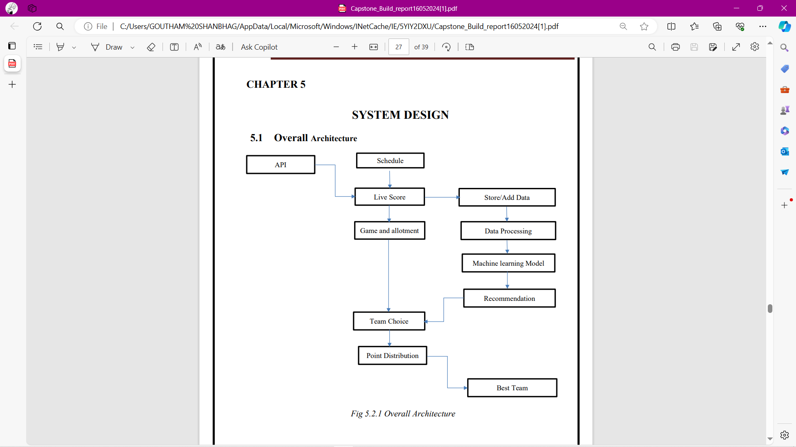
Architecture

Slide 6
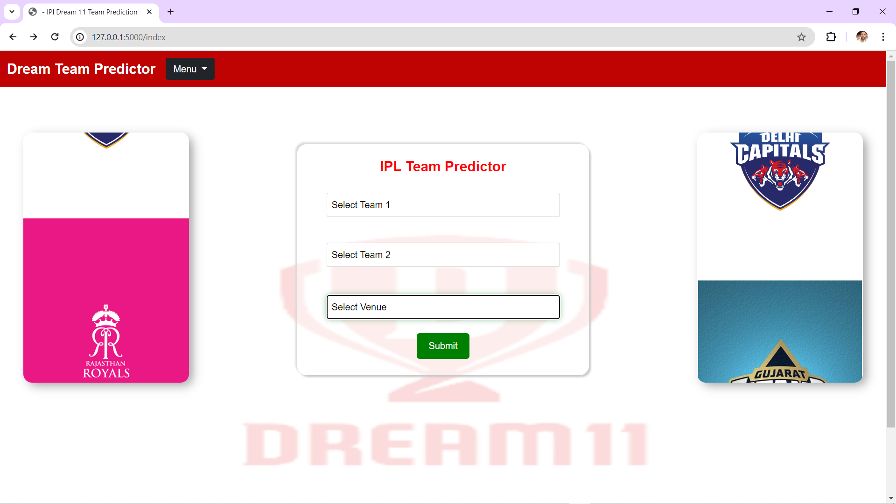
REsults

Slide 7
Conclusion
Sports fantasy websites have revolutionized the way sports enthusiasts engage with their favorite games by providing an immersive platform for creating virtual teams, strategizing player selections, and competing based on real-world performances.
These platforms not only amplify fan interaction and knowledge of the sports but also foster community building and skill development.
seamlessly blended entertainment, education, and camaraderie into a dynamic digital sports experience that continues to captivate and connect fans worldwide.
These websites have seamlessly blended entertainment into a digital sports experience that continues to captivate and connect fans worldwide.

Slide 8
Thank You

